Slide 1
MICRO PROJECT REPORT JAVA PROGRAMMING (22ITC31)
Submitted by
ARULVENTHAN GM (23EIR007)
ASWIN SAMPATH KUMAR (23EIR008)
ASWINI M (23EIR009)

Slide 2
Index
Problem Statement Problem Scope Methodology Implementation Results Conclusion

Slide 3
Problem Statement
Develop a Basic ATM System: Create a functional ATM system that can simulate real-world banking operations like those found in physical ATMs. User Authentication: Implement a robust authentication mechanism that allows users to access their accounts securely using either their account number or phone number. Core Banking Operations: Provide essential banking services such as depositing funds, withdrawing money, checking account balances, and calculating interest accrued on the account. Interest Rate Comparison: Incorporate a feature that allows users to compare interest rates offered by different banks, enabling them to make informed financial decisions.

Slide 4
Problem Scope
Account Validation: The ATM system should validate user input by verifying the entered account number or phone number against a predefined list of accounts. This ensures that only authorized users can perform operations.
Basic Banking Operations: Users should be able to:
Deposit Funds: Add money to their account balance.
Withdraw Funds: Withdraw money from their account, with validation to prevent withdrawals if there are insufficient funds.
Check Balance: View the current balance of their account.
Interest Calculation: Calculate simple interest based on a given rate and period.
Interest Comparison: Compare interest rates offered by different banks.
Account Management: The system should store account data, such as account numbers, balances, phone numbers, and birth dates, to allow users to manage their finances efficiently.
Security: While this is a simulation, the system should ensure that only valid transactions are processed, and it should prevent users from performing actions that would lead to errors (e.g., withdrawing more than the available balance).

Slide 5
ATM System Development Methodology
Requirement Gathering:
User Authentication (account number or phone number)
Deposit and Withdrawl Operations
Balance Inquiry
Simple Interest Calculation
Interest rate Comparision
System Design :
Object Oriented Approach.
Account class: Stores the account informations.
ATMTransactionSystem class:Manages ATM operations, and calculations.
Exception Handling: Handles more errors like Insufficient Balance.

Slide 6
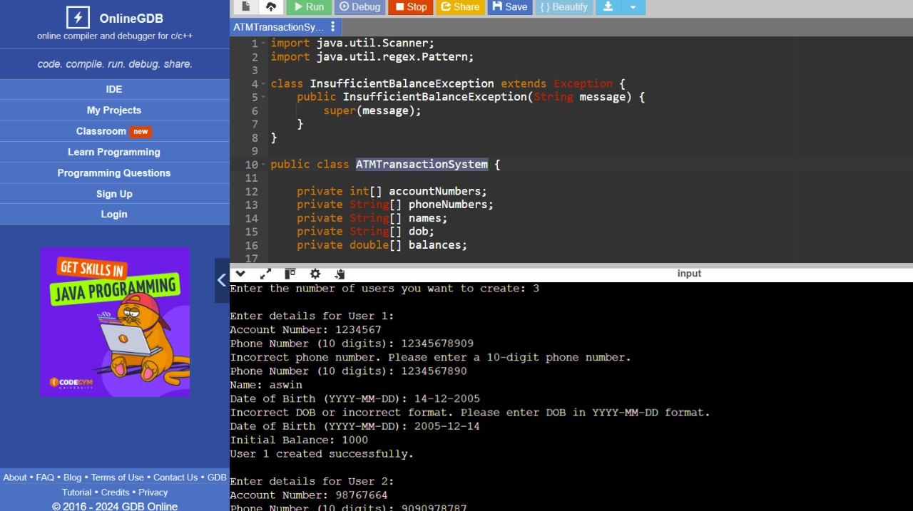
Output

Slide 7
Thank you

